Slide 1
AI-900: AI Fundamentals Introduction
Date17 JAN 2025

Slide 2
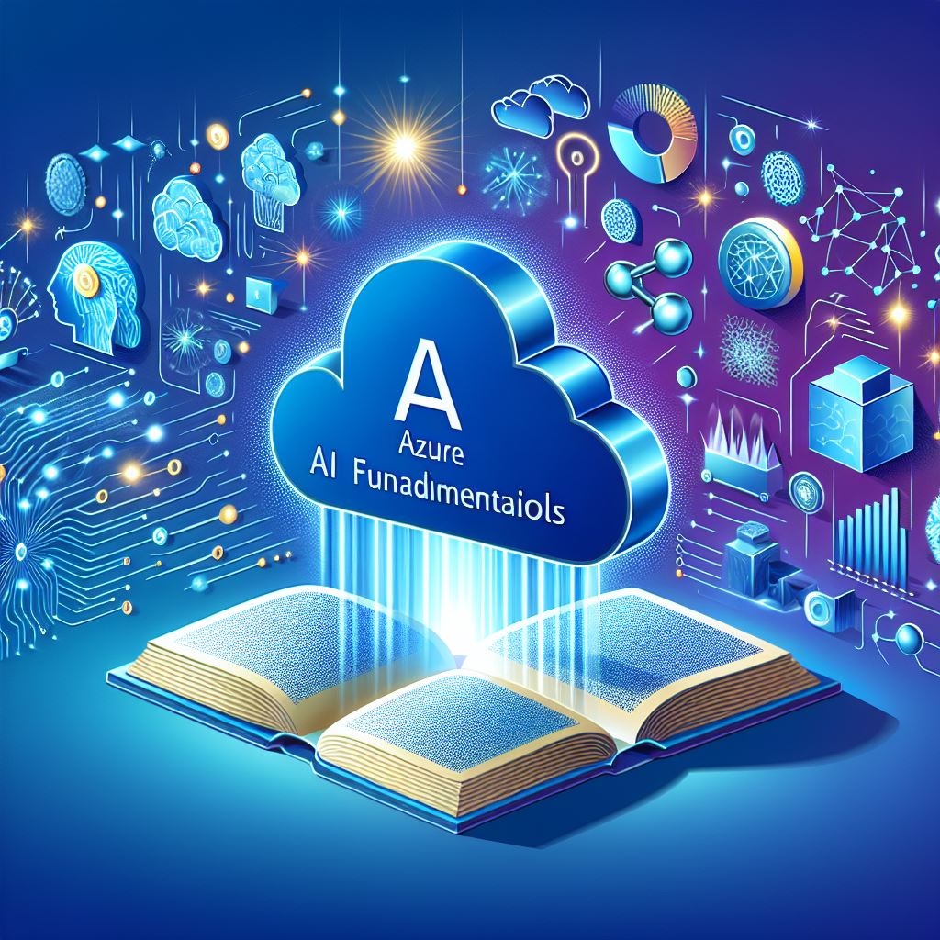

Azure AI fundamentals training & certification
This certification is an opportunity for you to demonstrate knowledge of machine learning and AI concepts and related Microsoft Azure services.
As a candidate for this certification, you should have familiarity with the self-paced or instructor-led learning material.
This certification is intended for you if you have both technical and non-technical backgrounds.
Data science and software engineering experience are not required. However, you would benefit from having awareness of:
Basic cloud concepts & Client-server applications
You can use Azure AI Fundamentals to prepare for other Azure role-based certifications like Azure Data Scientist Associate or Azure AI Engineer Associate, but it’s not a prerequisite for any of them.

Slide 3

AI TRACK AGENDA
Course Intro (ARTURO)
Azure AI fundamentals (LUCY)
Break
Computer Vision (ALEX)
Document Intelligence and Data Mining (TIFFANY-ARTURO)
Break
Natural Language Processing– NLP (ARTURO)
Introduction to GenAI - Azure OpenAI (TIFFANY)
Course conclusion (ALEX)

Slide 4
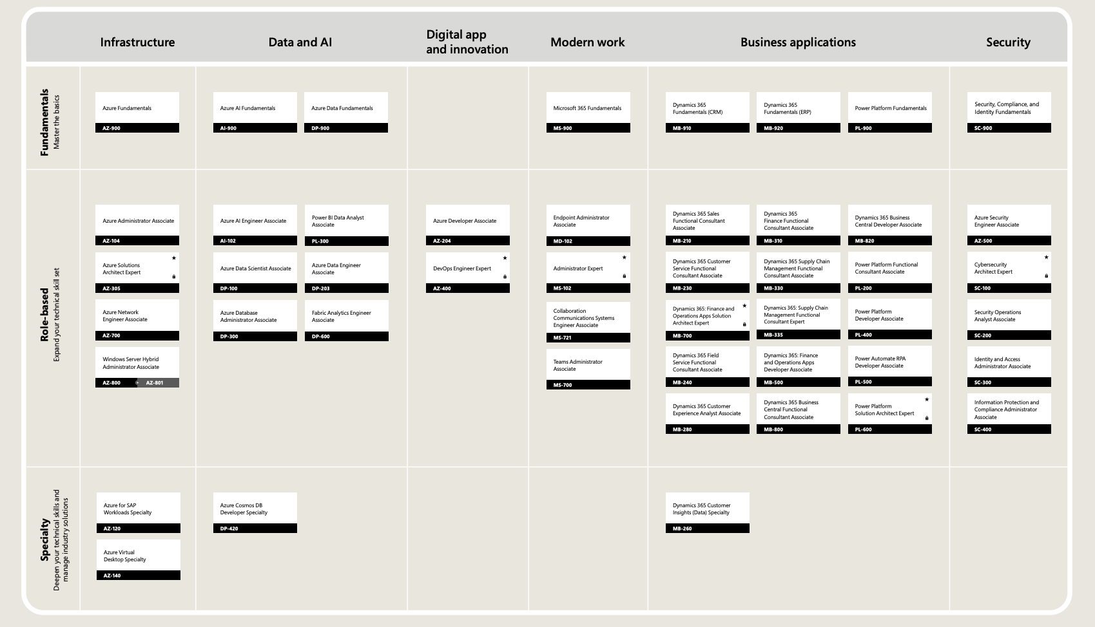
MS LEARN LEARNING PATH for AI-900 Exam
AZURE AI FUNDAMENTALS LEARNING PATH
STUDY GUIDE

Slide 5

Get ready for your Microsoft Certification exam
Understand the skills measured by the exam
Build confidence in your skills
Study area | Percentage
Describe Artificial Intelligence workloads and considerations | 15-20%
Describe fundamental principles of machine learning on Azure | 20-25%
Describe features of computer vision workloads on Azure | 15-20%
Describe features of Natural Language Processing (NLP) workloads on Azure | 15-20%
Describe features of generative AI workloads on Azure | 15-20%
Find in the exam page resources to help prepare
Watch exam prep videos
Review the exam study guide
Demo the exam experience with the exam sandbox
Take a practice assessment
Percentages indicate the relative weight of each area on the exam
The higher the percentage, the more questions you are likely to see in that area

Slide 6
Azure AI Fundamentals – exercises (1)
https://microsoftlearning.github.io/mslearn-ai-fundamentals/Instructions/Labs/01-machine-learning.html
https://microsoftlearning.github.io/mslearn-ai-fundamentals/Instructions/Labs/02-content-safety.html
https://microsoftlearning.github.io/mslearn-ai-fundamentals/Instructions/Labs/03-image-analysis.html
https://microsoftlearning.github.io/mslearn-ai-fundamentals/Instructions/Labs/04-face.html
https://microsoftlearning.github.io/mslearn-ai-fundamentals/Instructions/Labs/05-ocr.html
https://microsoftlearning.github.io/mslearn-ai-fundamentals/Instructions/Labs/06-text-analysis.html
https://microsoftlearning.github.io/mslearn-ai-fundamentals/Instructions/Labs/07-question-answering.html

Slide 7
Azure AI Fundamentals – exercises (2)
https://microsoftlearning.github.io/mslearn-ai-fundamentals/Instructions/Labs/08-conversational-language-understanding.html
https://microsoftlearning.github.io/mslearn-ai-fundamentals/Instructions/Labs/09-speech.html
https://microsoftlearning.github.io/mslearn-ai-fundamentals/Instructions/Labs/15-translation.html
https://microsoftlearning.github.io/mslearn-ai-fundamentals/Instructions/Labs/10-document-intelligence.html
https://microsoftlearning.github.io/mslearn-ai-fundamentals/Instructions/Labs/11-ai-search.html
https://microsoftlearning.github.io/mslearn-copilot/Instructions/Labs/01a-m365-copilot.html
https://microsoftlearning.github.io/mslearn-ai-studio/Instructions/01-Explore-ai-studio.html
https://microsoftlearning.github.io/mslearn-ai-studio/Instructions/06-Explore-content-filters.html

Slide 8


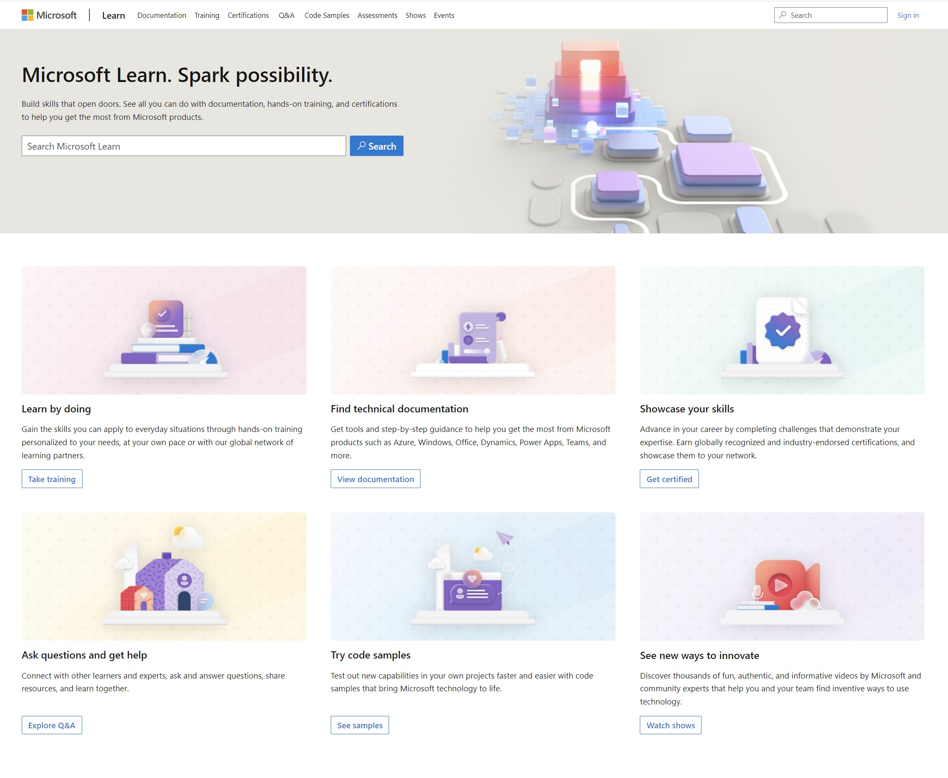
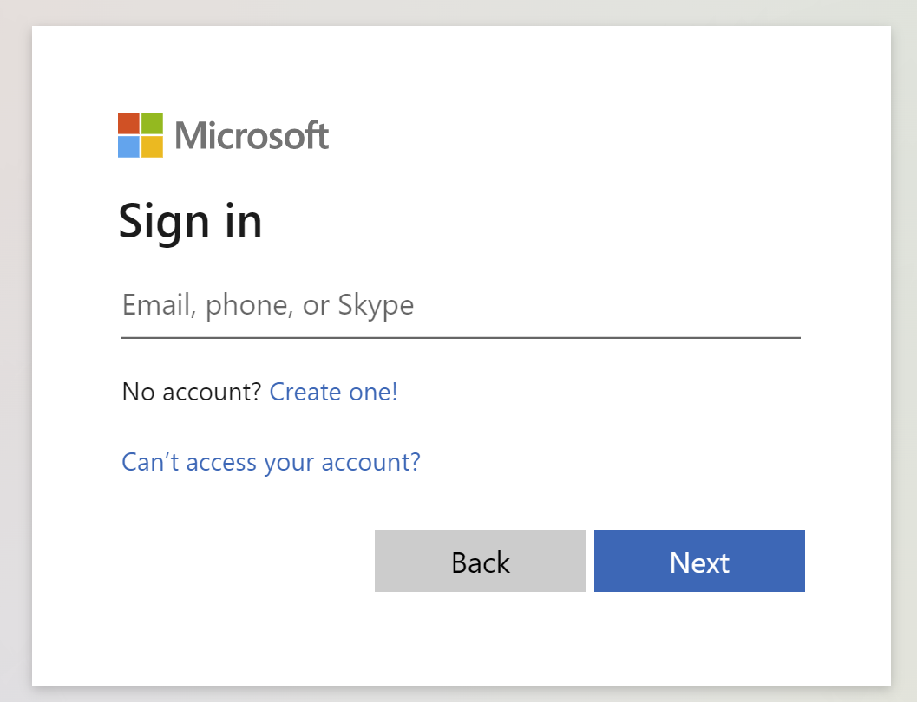
Get the most out of your Microsoft Learn profile
Create your Microsoft Learn profile at learn.microsoft.com
Select Sign in at the top, right corner of any Microsoft Learn page.
Follow the Microsoft account authentication process.
If the account that you have chosen to sign-in with doesn't already have a Microsoft Learn profile, you’ll be guided to create one.
Verify, track, and share your training and certification progress and accomplishments—all on one platform
Claim your achievement code for this course and share you have completed it.
Access your course material and track progress on your learning activities.
Share and verify your Microsoft Certifications via email, on social networking platforms, and on your résumé.
Download and print transcripts and certificates.
Manage your upcoming activities and certification exam appointments.
www.aka.ms/MyMicrosoftLearnProfile

Slide 9
Access your course material
All course content is available on Microsoft Learn
learn.microsoft.com/training/courses/browse
This course includes labs:
We’ll go through this content together and as the course progresses, I will advise you on which modules to review.
You can provide feedback for modules on Microsoft Learn. Find how at the bottom of each page.
Instructors will provide detailed lab instructions.
aka.ms/mslearn-ai900

Slide 10
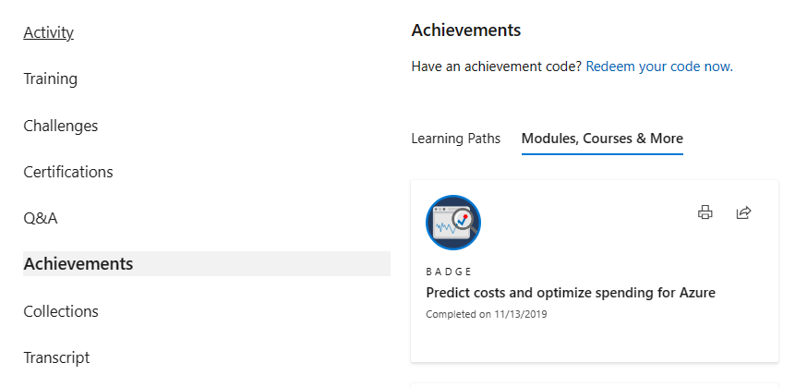
Celebrate your accomplishments and feel empowered
Get your achievement recognized and earn your badge for completing this course
aka.ms/MyMicrosoftLearnProfile
2
Go to Achievements on your Microsoft Learn profile
Redeem the code provided by your trainer
Find your new badge on Modules, Courses & More
Share your new achievement with your professional network. You can also download and print your certificate.
3
4
1

Slide 11
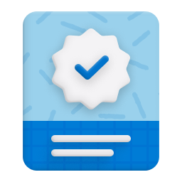
Become Microsoft Certified
92%
of certified IT professionals feel more confident in their abilities after earning certifications¹
Get recognized by earning industry validation for technical knowledge. Ensure you stay current with the necessary skills and expertise for continued success​.
Start at learn.microsoft.com/certifications
Microsoft role-based and specialty certifications require annual renewal.²
Learn about certification renewal at aka.ms/RenewYourCert
¹ “2023 Value of IT Certification | Candidate Report,” Pearson VUE, 2023 ² Microsoft fundamentals certifications don’t expire

